Slide 1

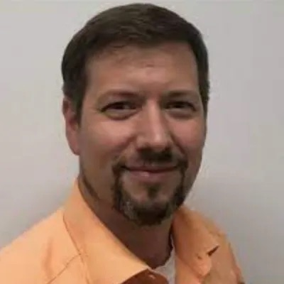
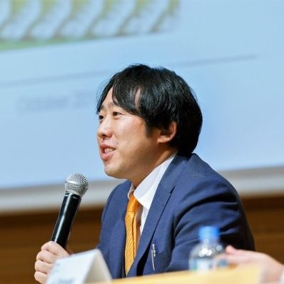

Goodbye
Shane
Marcel
Endo San
Host
Chair
GM
OpenChain Automotive Work Group – A Face-to-Face Meeting

Slide 2
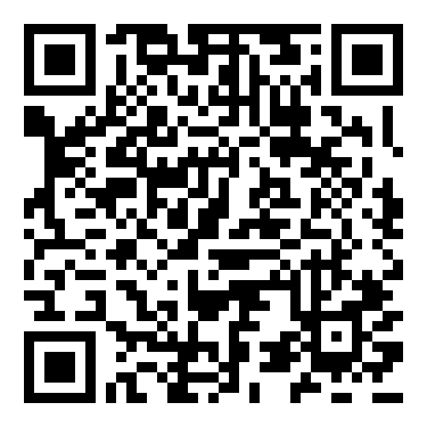
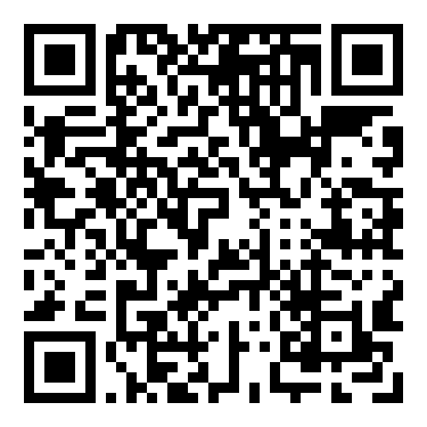
Get Overviews of Our Standards Online
ISO/IEC 5230:2020 Open Source License Compliance
ISO/IEC 18974:2023 Open Source Security Assurance

Slide 3
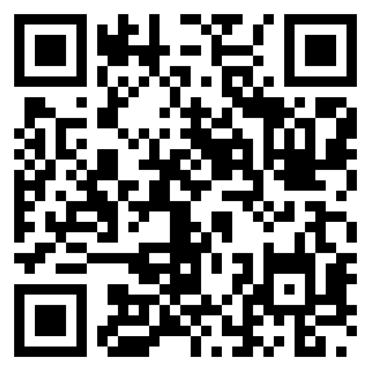
Track All Our Work
Our calls are open and publicly listed.
We publish a recording of every meeting not under Chatham House Rule.
We provide access to work groups, special interest groups and local work groups via mailing list.
We also use Slack and WeChat.
All the details can be found on our participation page.

Slide 4
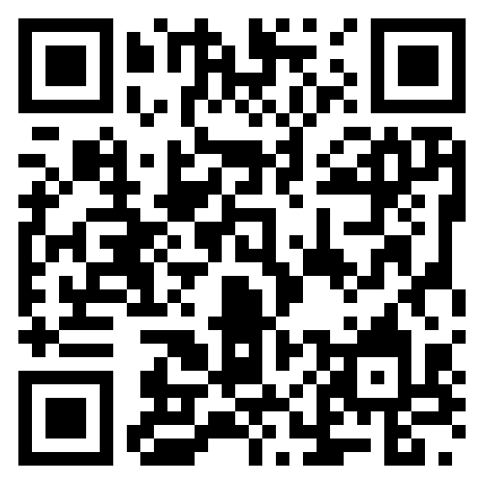
Get Free Reference Material
The OpenChain Project has extensive reference material:
Reference open source training slides
Policy template material
Supplier education material
Self-certification checklists and questionnaires
+ many, many more documents

Slide 5





Case Studies

Slide 6
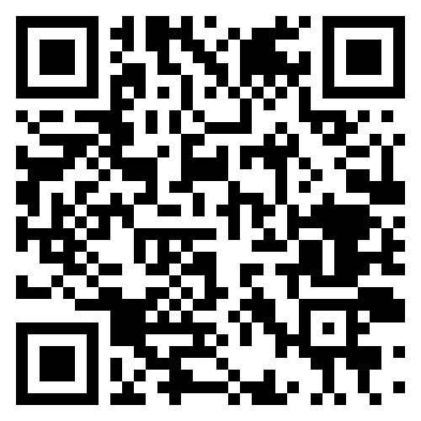
Order Printed Leaflets and Case Studies
The Supplier Education Leaflet
The Three-Way Case Study with BlackBerry and OSS Consultants
The Telco SBOM Guide
And more…

Slide 7
Thank You!
www.openchainproject.org

